Slide 1
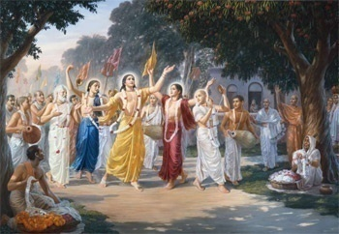
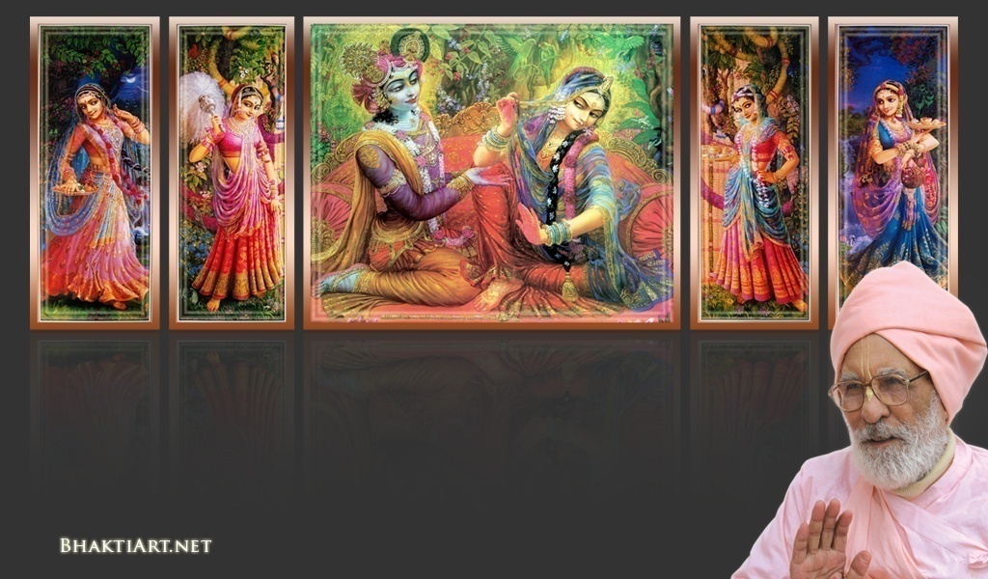
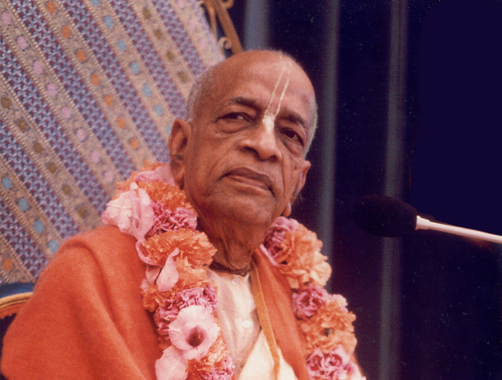
Sri Krsna Caitanya Prabhu Nityananda
Sri Advaita Gadadara Srivasadi
Gaura Bhakta Vrinda
Week 354
Aug 21
2015
Hare Krsna Hare Krsna
Krsna Krsna Hare Hare
Hare Rama Hare Rama
Rama Rama Hare Hare
Gokul Bhajan & Vedic Studies
North Carolina, USA
Notes:
Om Ajnana timirandhasya, jnananjana salakaya
Caksur unmimiltam yena, tasmai sri gurave namah
Namah om vishnu padaya, radhikayah priyatmane
Sri-srimad bhaktivedanta, narayana iti namine
Narayanam gurum vande, Saranam bhakta bāndhavam
Gaura manobhishtam poornam, Radha dāsyam pradāyakam
Rupānugācarya varyam, Rupa manjari preshtakam
Patita pāvana bāndhava, Yugācarya nārāyanam
Sri krishna lila kathane sudaksham, Audarya-madhurya gunais ca yuktam
Varam varenyam purusham mahantam, Narayanam tvam sirasa namami
He krishna karuna sindho, dina bandho jagat pate
Gopesha gopika kanta, radha kanta namo ‘stu te
Tapta kancana gaurangi, radhe vrindavaneshvari
vrsabhanu sute devi, pranamami hari priye
bhajami radham aravinda netram, smarami radham madhurasmi-tasyam
vadami radham karuna bharardram, tato mam anyasti gatir na kapi
bhaktya vihina aparadha-laksaih, ksiptas ca kamadi-taranga-madhye krpamayi tvam saranam prapanna, vrnde namas te caranaravindam
--------------------------
First of all, I pay my koti dandavat pranams to my diksha guru Om vishnupada rupanuga acharya Sri Sri Bhakti Vedanta Narayana Goswami maharaja. My koti dandavat pranams to Sri Sri Bhakti Vedanta Swami Prabhupada, and guru varga.
My humble pranams at the lotus feet of all assembled devotees, vaishnavas and vaishnavis..

Slide 2
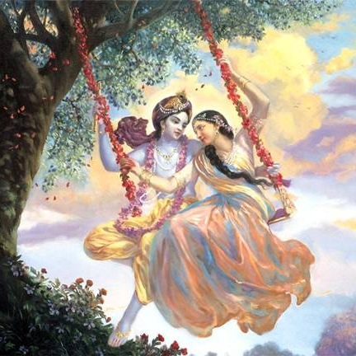
Jaya Rādha Mādhava
Jaya Kunja Vihārī
Jaya Gopī Jana Vallabha
Jaya Giri Vara Dhārī ... (Jaya)
Yaśodā Nandana Vraja Jana Ranjana
Yamunā tīra Vana Cāri ... (Jaya)
[ Hare Krishna Hare Krishna
Krishna Krishna Hare Hare
Hare Rāma Hare Rāma
Rāma Rāma Hare Hare ]

Slide 3
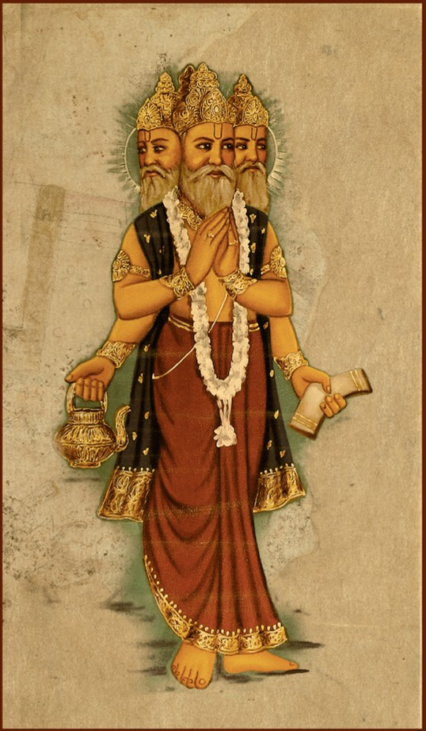
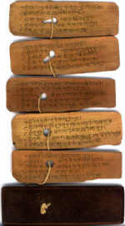
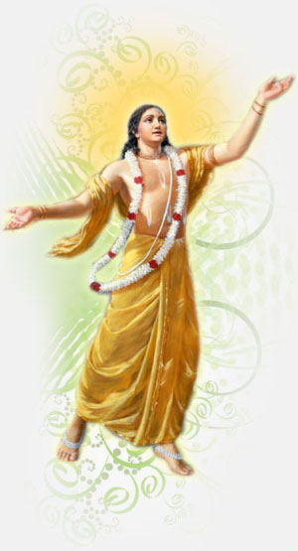
Slides Video
Brahma Samhita

Slide 4
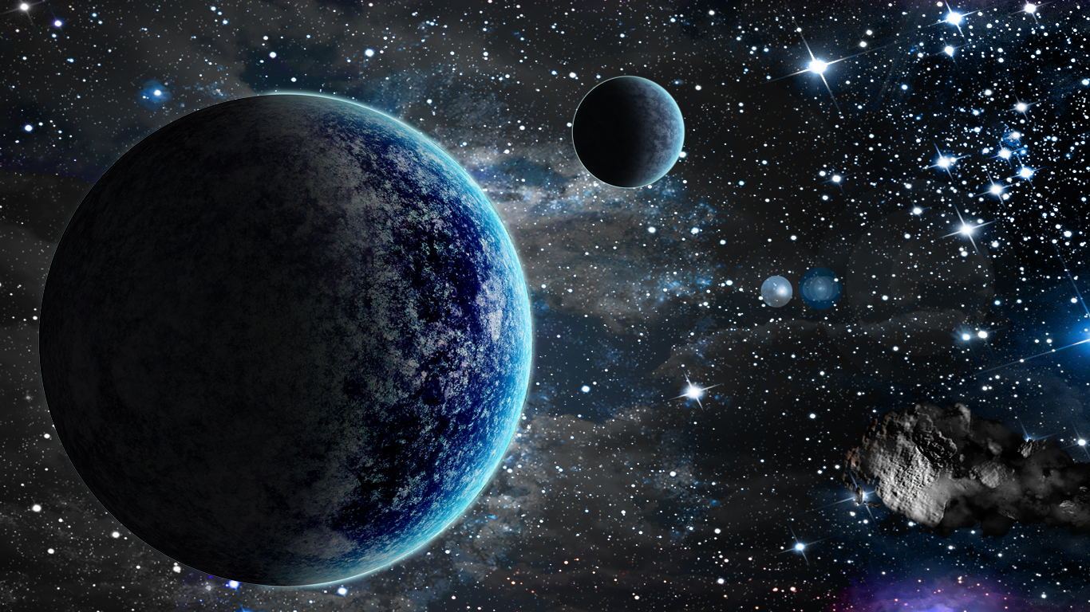
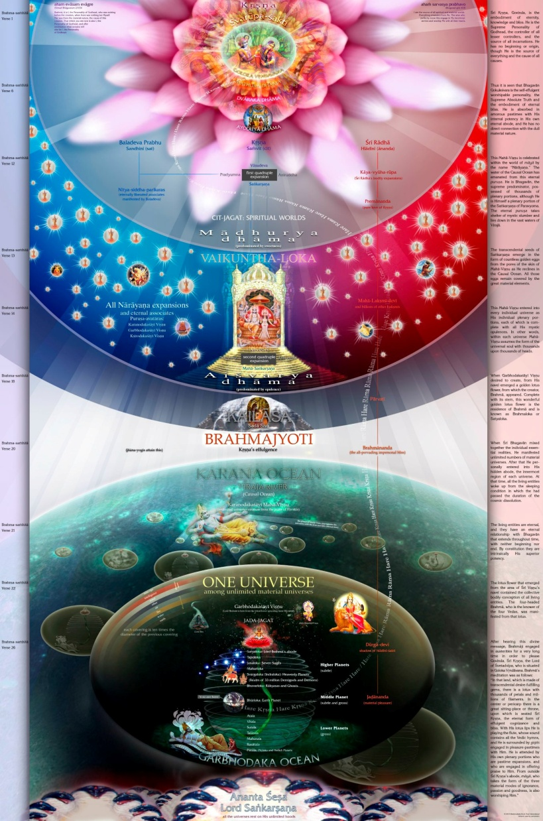
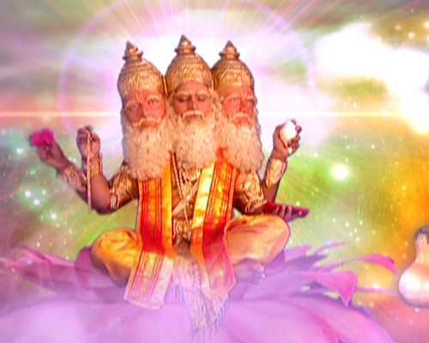
Sri Brahma Samhita: Verse-33

Slide 5
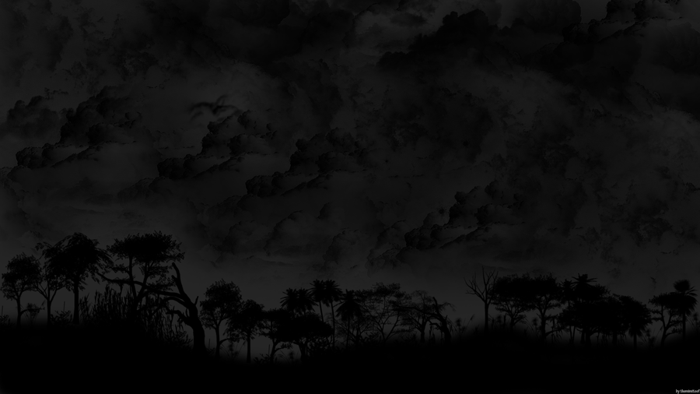
BS - 33
advaitam acyutam anādim ananta-rūpam
ādyaḿ purāṇa-puruṣaḿ nava-yauvanaḿ ca
vedeṣu durlabham adurlabham ātma-bhaktau
govindam ādi-puruṣaḿ tam ahaḿ bhajāmi
I worship Govinda, the primeval Lord, who is inaccessible to the Vedas, but obtainable by pure unalloyed devotion of the soul, who is without a second, who is not subject to decay, is without a beginning, whose form is endless, who is the beginning, and the eternal purusha; yet He is a person possessing the beauty of blooming youth.

Slide 6
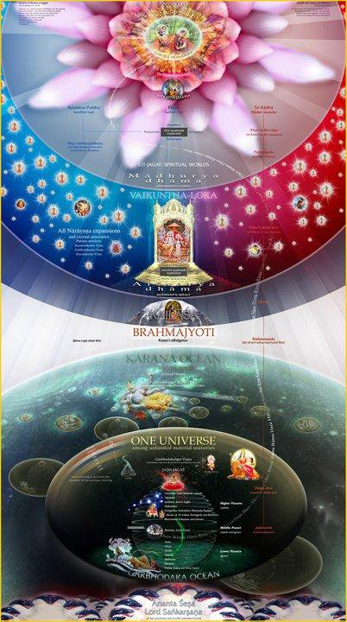
advaitam - without a second
acyutam - without falling
anādim - without beginning
ananta - endless
rūpam – form
ādyaḿ - the beginning
purāṇa - most ancient
puruṣaḿ - person
nava - blooming
yauvanaḿ – youth
ca - also

Slide 7
vedeṣu - through the vedas
durlabham - inaccessible
adurlabham - not difficult to get
ātma-bhaktau – by devotion at soul
govindam - Lord Govinda (Krsna)
ādi - original
puruṣaḿ - person
tam - Him
ahaḿ - I
bhajāmi - worship

Slide 8
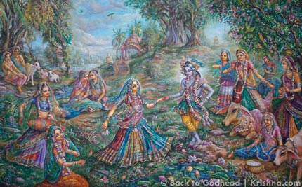
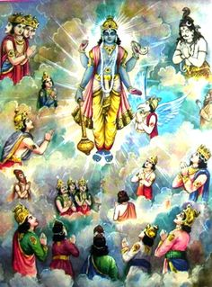
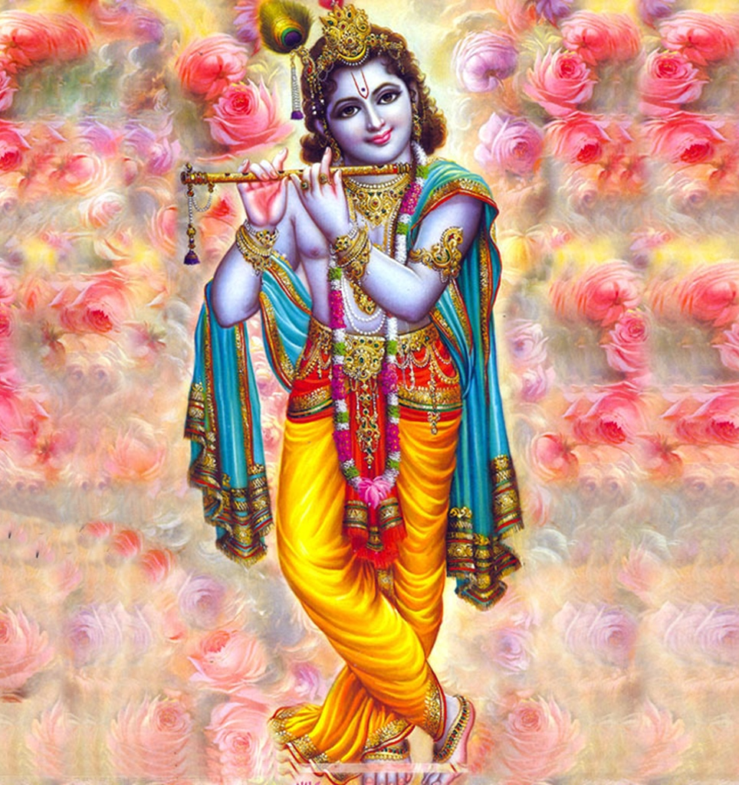
Notes:
advaitam acyutam anādim ananda rupam...
advaitam - without a second
acyutam - without falling
anādim - without beginning
ananta rupam- endless form
Why all negative? ‘a’ ?
Because, in this world, we see:
Two or Many things, all less superior and full of defects..
Fallen jivas everywhere
Has beginning (birth), and
Has ending (dead)
.....
What you on the left is just Vishnu, and we will see about this expansion in a class later.
Vishnu, Maha Vishnu, and Narayana and others are expansions of Lord Krishna. They are not avatars, but expansions.

Slide 9
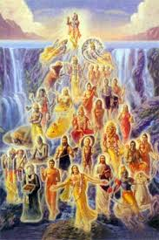
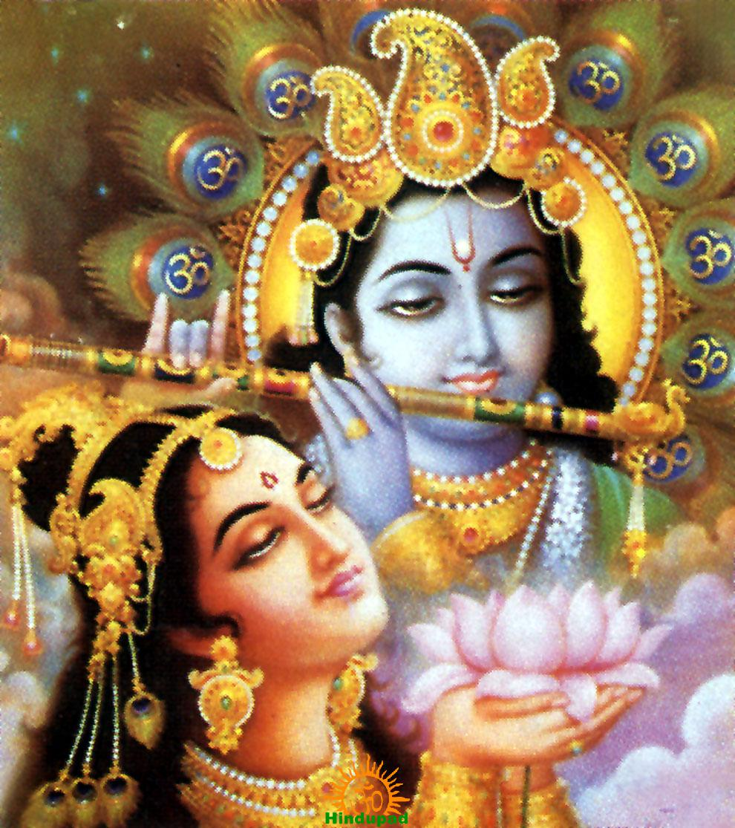
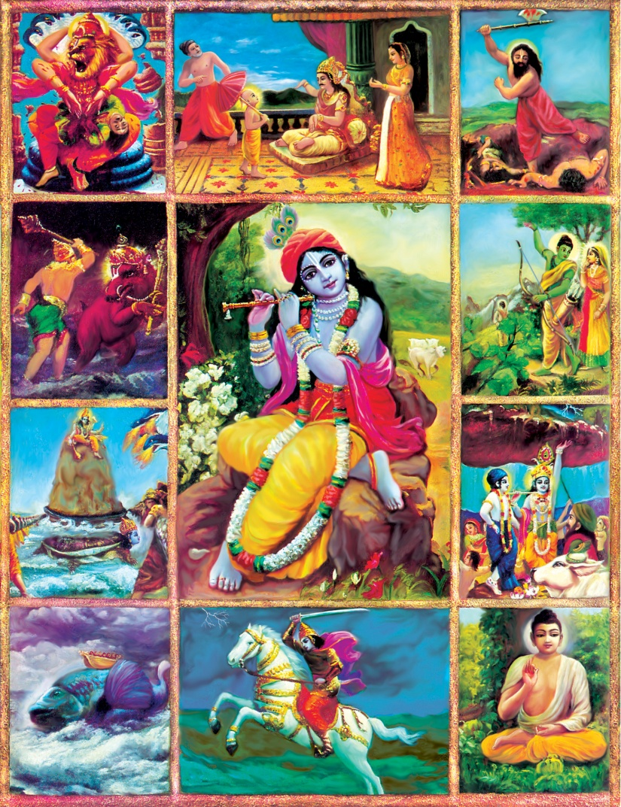
Notes:
ādyaḿ purāṇa-puruṣaḿ..
ādyaḿ - the beginning
purāṇa - most ancient
puruṣaḿ - person
The oldest?
Then does he look old?
.....

Slide 10
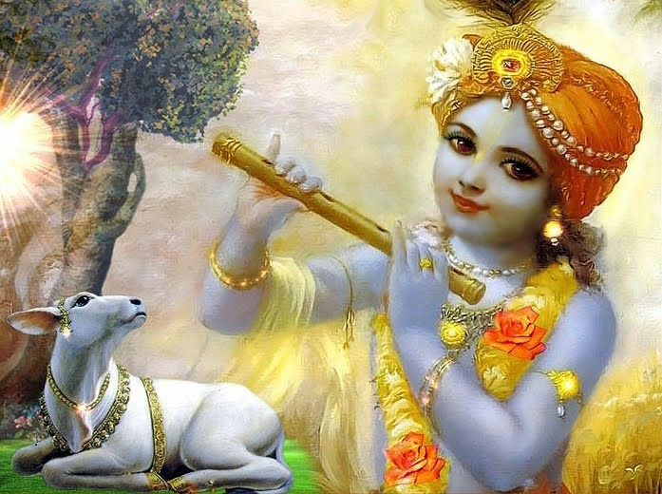
Notes:
No.. He is always youthful!
Yauvanam.

Slide 11
Notes:
We age, but not Krishna!
He is always of Nava (blooming) yauvana (youth)..!
In this world, we have the 4 defects.. What are they?
Birth, Disease, Old Age and Death..
Who can conquer these?
Scientists are trying hard. They want you to believe them that they will find a solution..
But not not even a single scientist lived past 100 years?
How can you believe them?

Slide 12
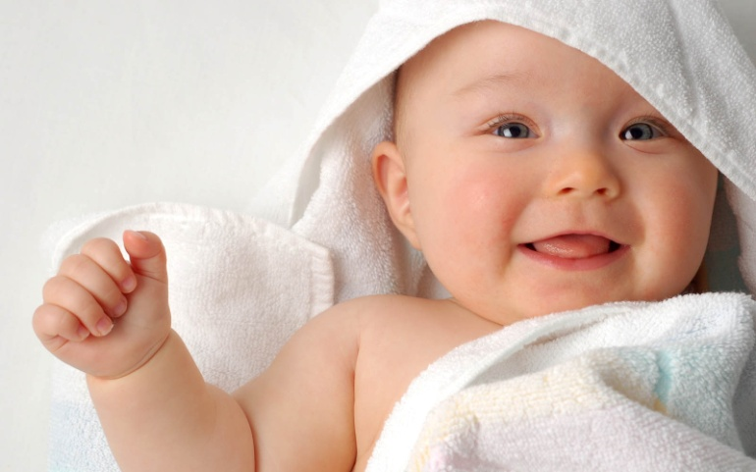
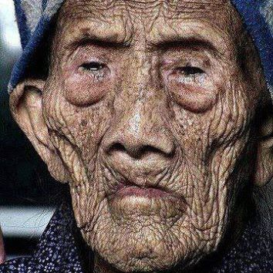
Notes:
We age, but not Krishna!
He is always of Nava (blooming) yauvana (youth)..!

Slide 13
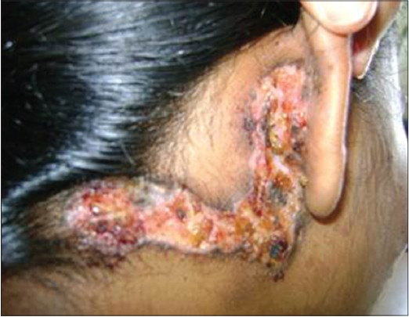
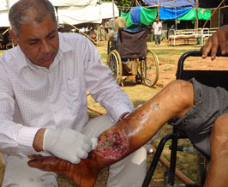
Notes:
What are the 4 defects of this world?
Birth, Disease, Old Age and Death..
Who can conquer these?
No one..
But there are so many dharmis and activists who says “Nara Seva is Narayana Seva!”
And fooling themselves..
You cannot find this in the sastras.. It is manufactured..
The real help you can do them is to stop all these 4 miseries..
Can you help in that?
No?
Then what use is it? Because they will be born again and again?
It is like chopping the leaves.. They will grow again!
Can you pull out the root?
No!

Slide 14
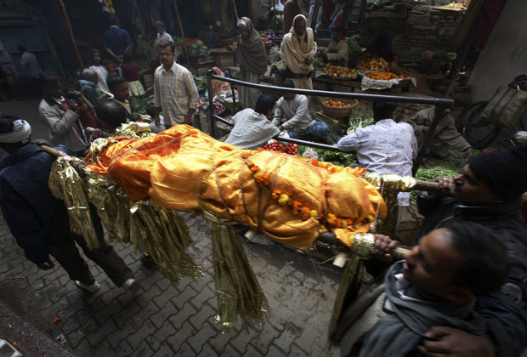
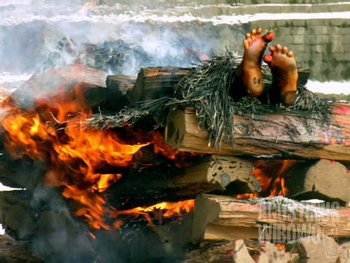
Notes:
Then the body one day gives up!
And it is taken to cremation...
The body that you alone was carrying for 24 hours a day had to be carried by 4 people at least..
Who was carrying your body all the time?
And that left..
What was that who left?

Slide 15
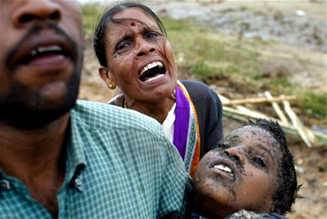
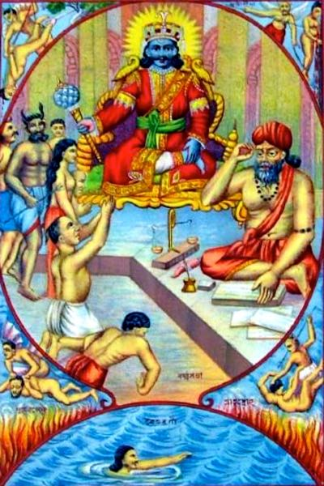
Notes:
But..
Have you seen his soul?
No..
Then why are you worrying about something that you have never seen?
Believe it or not..
Our death is SURELY coming..
Every day sun rises to remind you about another day is starting..
And it sets reminding that another day is gone and you are one more day near the death..
When it comes it will be too late..
.. We knew a close friend, young.. In VA..
All of a sudden she was diagnosed with liver cancer..
Went thru so many things.. None worked..
Then took radiations.. The hairs were falling off.
On the last day before pulling the life support off, she and her husband were together..
And the next day, she was gone !!!!

Slide 16
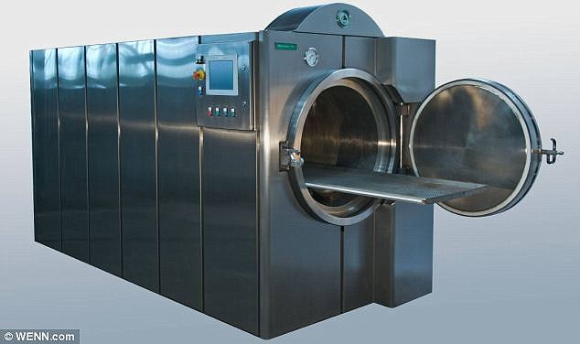
Notes:
What is this machine?
I saw it by myself when in VA.
She was very yong... Died of liver cancer.
I took both my boys to the place.. Why?
Her son was a close friend of my sone.
The body was placed in a tray. The vedic priest chanted..
Many placed nice flowers...
Then they closed the door..
And they turned on the machine.... I was screaming inside when it was closed..

Slide 17
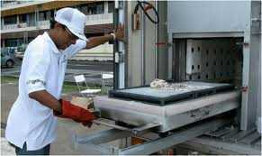
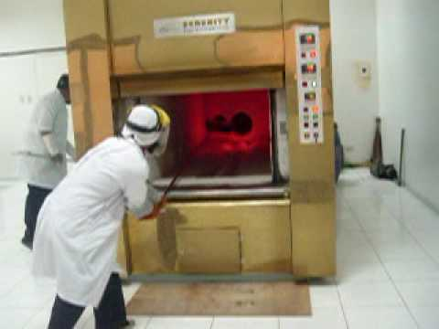
Notes:
And after some time, the attendant pulled out the tray..
What do we get?

Slide 18
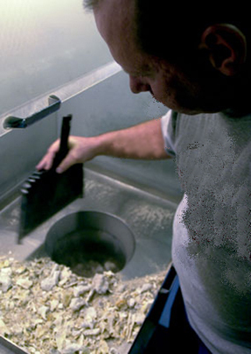
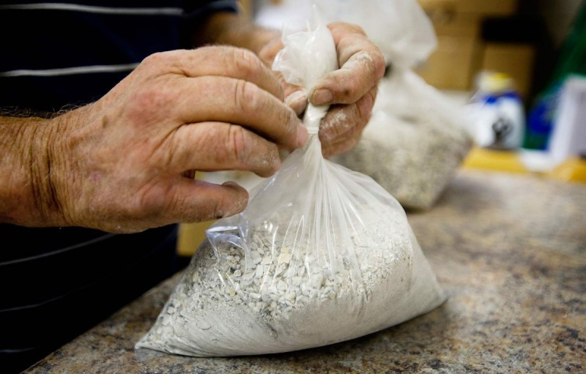
This what remains after cremation & one can take back ...
Notes:
Well, this is what it was..
Believe me! That is you.. Yes that is you!
It was given to her husband to take it with him!
He carried it an urn and threw in Ganges!
Did anything at all help her?
She is now in a small ziplock bag!
Believe me.. Every one will end up in a ziplock bag or in the ground..

Slide 19
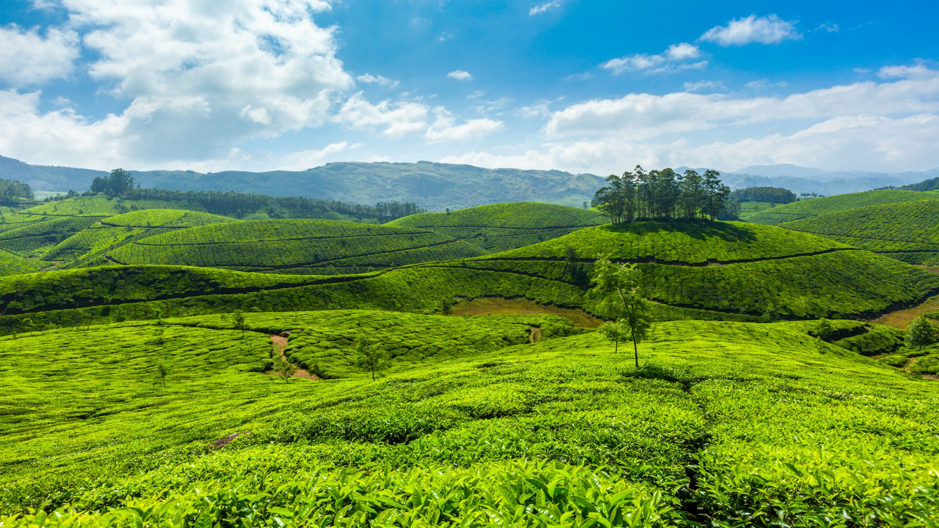
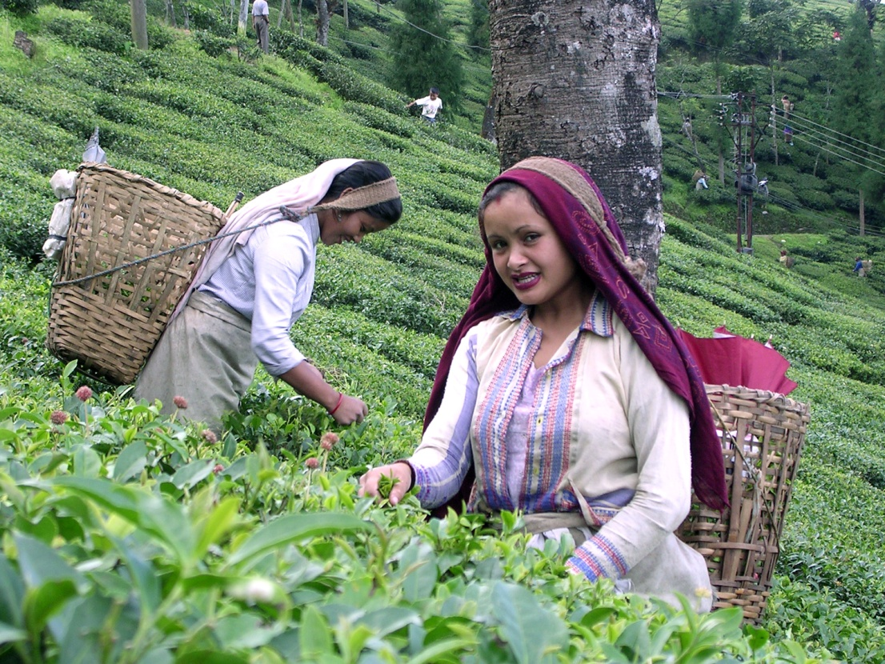
Notes:
Once trying to purchase an estate near Ooty..
Met the owner and he was telling..
This is all my estate.. I have more than 500 acres.. And my life belongs to here..
Mmm.. What will you do when you leave your body..
‘Oh.. As I own this estate, I want myself buried here..’
“O Fool! You do not own the land.. The land owns you.. It will disintegrate your body and absorb in its body!”

Slide 20
Notes:
But the spiritual world does not have any of these defects..
No birth, no disease, no old age, and no death....
And hence no cremation!
Always bliss.. Infact ever increasing bliss..
Why?
Because it is beyond the jurisdiction of material nature.. There is NO MAYA there..

Slide 21
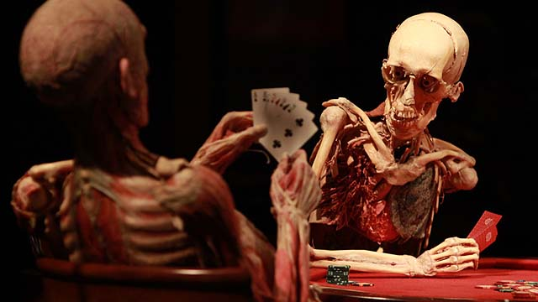
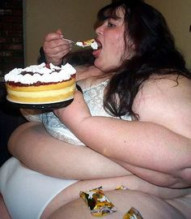
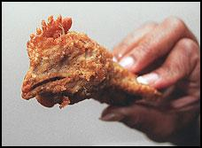
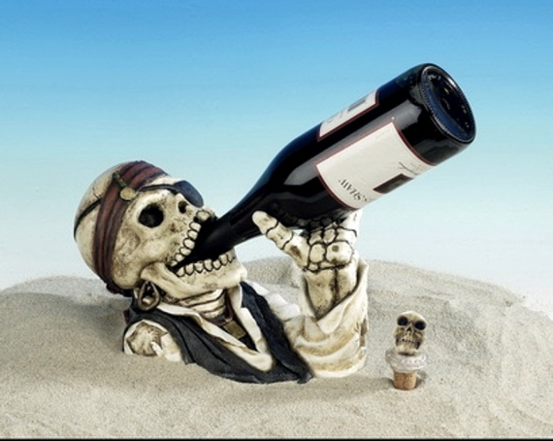
Notes:
But here we are in MAYA
Because we are so ignorant like a DONKEY about the future of our life..
And so ignorant that our action in this world decides our next world..
And we are so fool to just worry about our tonge..
We become the killer of our own soul!
That husband was alone for some time..
Then, MAYA took him over..
Now he is married again..
..... And we all know our death is also going to come.. Just a metter of when..
Can we get another human body?
Not easy!

Slide 22
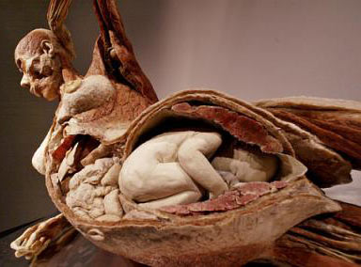
Notes:
Wso, what will an intelligent person do?
Do the needful so that We should not be born again!PERIOD!
Nothing else is important..
But what should we do?

Slide 23
Notes:
Gurudev tells us that our only business is to chant the holy names of the Lord.
That is the only one that can save us..

Slide 25
Notes:
And we will reach His abhode!
What are the best things about His abhode?
No birth, no disease, no old age and no death!
Why? Because we attain His qualities due to His mercy..
He is NAVA Yavana .. What is nava Yavana?
What kind of youth He is in?

Slide 26
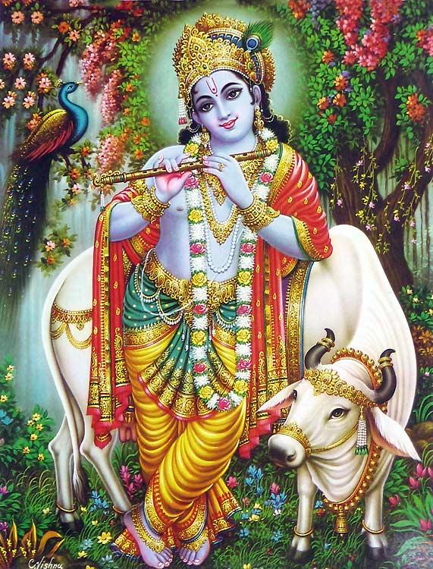
kaumāram panca mab-dantam
paugandam dasa mavadhi
kaisoram a-panca dasad
yauvanam tu tatah param
'The kaumara stage lasts until the age of five, pauganda up to age ten and kaisora to age fifteen. From then on, one is known as yauvana.'
Notes:
He is
.... nava-yauvanaḿ ca
Nava - blooming
Yauvanam – Kishora – fifteen years youth
Krishna’s beauty is always showing more and more beautiful..
Every day, He is more beautiful and more fresh..
What kind of youth he is in Goloka?
He is in KAISHORAM stage..
That is the form of Nanda Nandan Krishna, Yashoda Nandan Krishna.

Slide 27
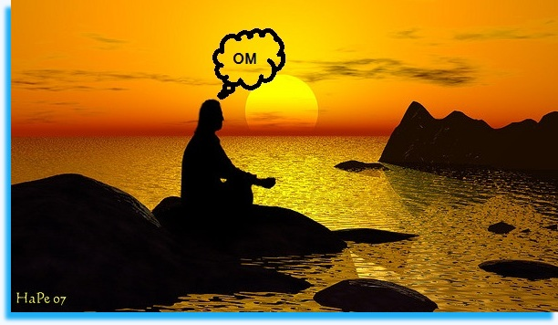
Notes:
But who can one achieve Goloka?
Can I chant Om and go?
BIG NO!
In truth, it is not possible to go there!
What about the 4 sampradaya?
Answer is: NO!
Goloka is not Calcutta!
Any one can go to Calcutta, but not Goloka!
One can go to Vaikuntha, but not to Goloka!

Slide 28
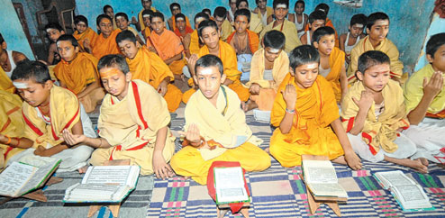
Notes:
What about Vedas? Can I study VEDAS and go there?
NO.. Certainly not.. Dry Vedic Sholars have no place in Goloka!
Krishna cannot be known by Vedas...
But we are studying the vedas for thosands and thosands of years..
If you study Vedas, you are considered like a Pundit and very respected..
But here it is said, Krishna cannot be known by Vedas.
But studying Vedas is for thousands and thosands of years..
Do they know this?
No!
vedeṣu durlabham ....

Slide 29
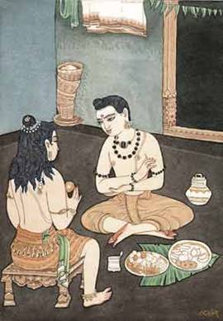
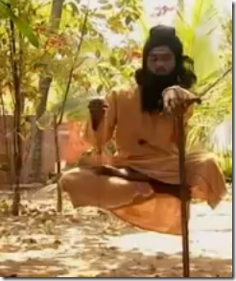
Notes:
And what about knowledge? The great Jnanis can go?
Krishna says in Gita clearly that he cannot be seen by Jnanis.
They can see paramatma but not Bhagavan Krishna.
If you want Krishna..
And that is the only goal for you..
Then, stay away from Jnanis and Yogis.
Remove your brain first.. Even if you try to understand Krishna slightly using your brain and logic, he goes FAR away.
All the Jnanis also talk about BHAKTI too..
But that has nothing to do with what we are talking...
They are talking about CHAAYA BHAKTI – the shadow – Not the real.

Slide 30
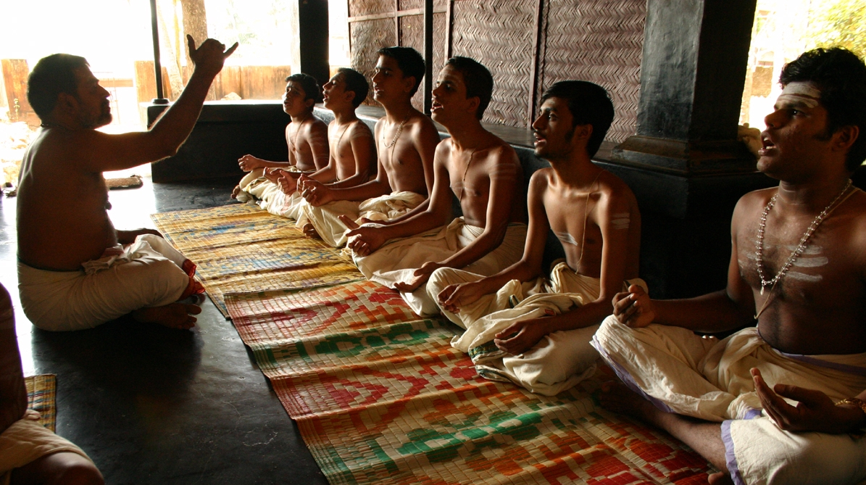
Notes:
Vedic scholars put Krishna away..!
No, actually Krishna went away from them..
He says again and again that He can never be understood by studying Vedas..
Then we do we call us ‘Vedic Studies’?
Vedas can do two things..
Can give you the apparent meaning, and
Its actual meaning
So it can bewilder you!
But if you know about Krishna from a devotee, they can give the real meaning..
Here is an example..

Slide 31
Keshavam patitam drushtwaa
Paandavaah harsha nirbharaah
Rudanti Kauravaah sarve
Ha ha Keshava Keshava
By seeing Keshava (Krishna) falling down (dead) during the course of the battle, Pandavas became very happy , whereas the kauravas started weeping and crying 'Ha Keshava Ha Keshava’
Notes:
Subhashitas
=======
By seeing Keshava (Krishna) falling down (dead) during the course of the battle,
Pandavas became very happy , whereas the kauravas started weeping
by saying 'Ha Keshav Ha Keshav‘

Slide 32
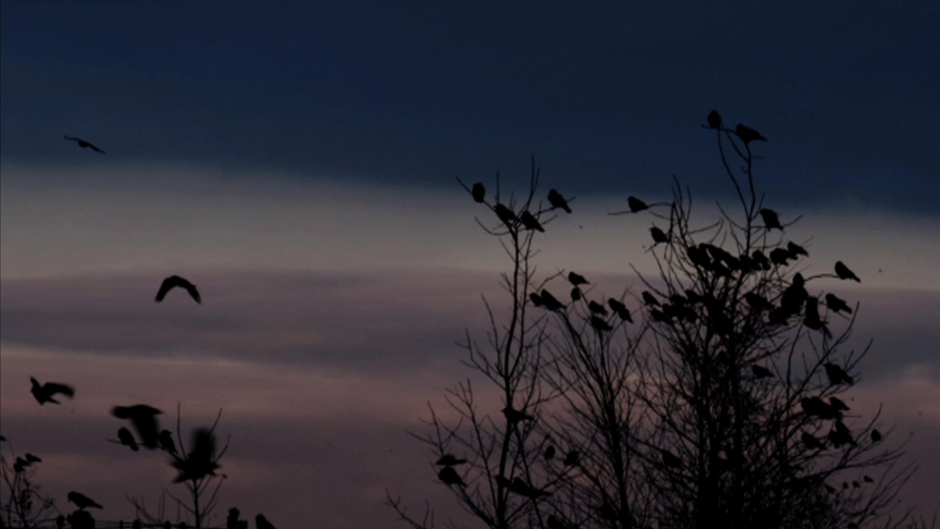
Keshavam patitam drushtwaa
Paandavaah harsha nirbharaah
Rudanti Kauravaah sarve
Ha ha Keshava Keshava
Notes:
Ka – Water, Ke – In the water (Locative Singular)
Shavam – dead body
Patitam – Fallen
Drushtwaa – During battle
Paandavaah – Group of Fish in water
Harsh - Laugh
Nirbharah - Louder
Rudanti – Cried bitterly
Kauravaah – Flock of Crows
Sarve – all
Ha Ha Keshava Keshava – O Dead body!

Slide 33
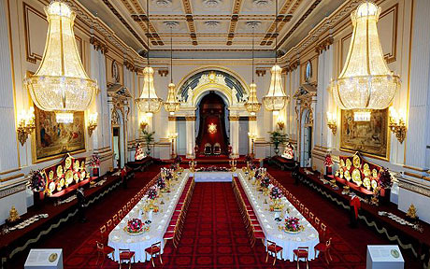
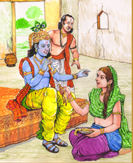
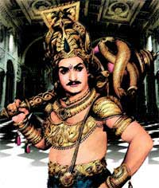
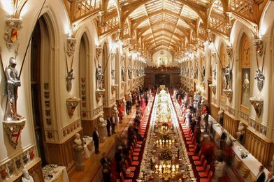
Notes:
Duriyodhana thought he could get Krishna under his control when he knew Krishna was coming.
He arranged the biggest feast to show his power and wealth..
But where did Krishna go?
Vidhura
Vidhuraani
He said he is not hungry and said he can’t have food with Dhuriyodhana.
Dhuriyodhana and his brothers tried to catch Krishna and tie Him..!
Can they?
Then Bhishma and Dronacharya invited to their places..
He did not even go to any of their places even though they all heartfully invited..
But without any invitation Krishna went to the hut of Vidhura..
Why? He was a dear-most bhakta!
In fact when Krishna reached, Vidura was not even at home.
(We cry for Krishna, He does not hear.. But here Krishna Himself was going after)
He knocked the door..”Mother... I am hungry!”
What did Vidhurani give?
Banana peel..!
Vidhura came, and saw the scene.. ‘Vidhurani.. What are you doing?”
Vidhurani came out from her prema.. Realised her mistake.. Shy and unhappy
Now she gave the banana itself and threw away the peel..
Krishna said,”No.. The other one was sweet!”
... adurlabham ātma-bhaktau

Slide 34
Notes:
PREMA – the highest devotional love is what Krishna wants..
Every jiva can attain Him..
One does not need to be a yogi or jnani..
In fact He says that Yogis and Jnanis cannot attain Him.
Even cows, trees, insects any jiva can attain Him if they have prema.
He is a Prema Rasika...
He is Rasika Balanam..
... adurlabham ātma-bhaktau

Slide 35
Notes:
His dear ones forgets that Krishna is the supreme god of all the gods..
Yoshoda will never every believe this..
For His dear bhaktas, He is the closest, and dear-most..
He reveals to them fully!
He is even controlled by them..
Why? For them, Krishna is everything! There is nothing no life other than Krishna.
... adurlabham ātma-bhaktau

Slide 36
Notes:
We understand that there are even bhaktas higher than mother Yashoda..
Lord Caitanya Mahaprabhu is the one who revealed the highest dimension of this highest spiritual abhode..
The Goloka
He is the Prema Purusha.
Why Prema Purusha? Because he is the only one who can give Prema. Other even including Lord Narayana cannot give it.
Krishna Himself came down to give this rare jewel..
But can any one understand?
No!
Can the four sampradaya give this?
No! Because their gurus themselves do not have that..

Slide 37
E-94
(Krishna Govindam Gopi Nayakam
Gokul Jeevanam Gopa Sākhyatam)
Premadam ca me kāmadam ca me
Vedanam ca me vaibhavam ca me
Jeevanam ca me jeevitam ca me
Daivatam ca me deva na 'param
Nanda Nandanam Nalina Sundaram
Nātya Shobhanam Nava Vichāranam
Murali Gānanam Madhura Bhāvanam
Nayana Lochanam Nāda Bheejanam ...(Prema)
Padma Nābhanam Prema Kāntanam
Parama Chetanam Bhakta Bhoshanam
Bandha Chedanam Purushottamam
Bhuvana Rakshakam Pari Paalanam ... (Prema)
Manda Hāsanam Madana Mohanam
Māya Leelanam Madhu Sudhanam
Meha Varnanam Man-Manoharam
Moola Tāranam Mantra Rupakam ... (Prema)

Slide 38
BS - 33
advaitam acyutam anādim ananta-rūpam
ādyaḿ purāṇa-puruṣaḿ nava-yauvanaḿ ca
vedeṣu durlabham adurlabham ātma-bhaktau
govindam ādi-puruṣaḿ tam ahaḿ bhajāmi
I worship Govinda, the primeval Lord, who is inaccessible to the Vedas, but obtainable by pure unalloyed devotion of the soul, who is without a second, who is not subject to decay, is without a beginning, whose form is endless, who is the beginning, and the eternal purusha; yet He is a person possessing the beauty of blooming youth.

Slide 39
QUESTIONS?
Notes:
advaitam - without a second
acyutam - without falling
anādim - without beginning
ananta - endless
rūpam – form
ādyaḿ - the beginning
purāṇa - most ancient
puruṣaḿ - person
nava - blooming
yauvanaḿ – youth
vedeṣu - through the vedas
durlabham - inaccessible
adurlabham - not difficult to get
ātma-bhaktau – by devotion at soul

Slide 40
Thus ends...
GBVS Brahma Samhita Episode - 05
(Verse 33)

